Slide 1
Perimeter and area

Slide 2
Perimeter & area

Slide 3
Perimeter is the total length of the boundary of a two dimensional shape.
Units – km, m, cm, mm, miles, inch etc.
Area is the measure of how much space there is on a flat surface (2-D). The area of a flat, or plane figure is the number of unit squares that can be contained within it.
Units – m², cm², km², mm², square inches etc.

Slide 4
Square and rectangle
l
h
l
b
Square
Perimeter = 4l
Area = l²
Rectangle
Perimeter = 2(b+h)
Area = bh

Slide 5
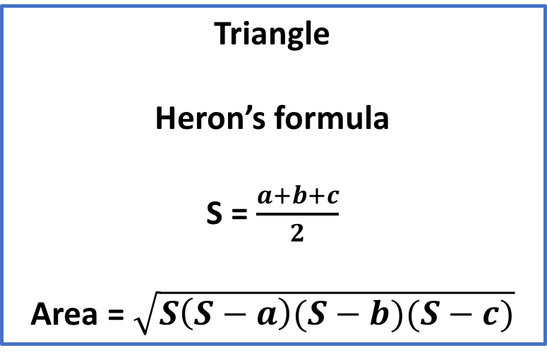
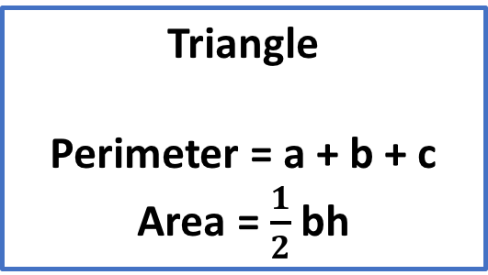
Triangle
Triangle
Perimeter = a + b + c
Area = $\frac{1}{2}$ bh
a
c
h
Triangle
Heron’s formula
S = $\frac{a+b+c}{2}$
Area = $\sqrt{S\left(S−a\right)(S−b)(S−c)}$
b

Slide 6
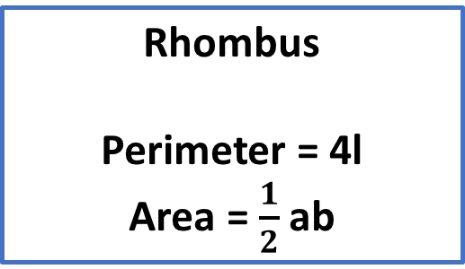
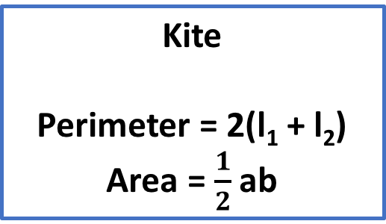
Rhombus and kite
l₁
b
|
a
b
|
|
l
a
l₂
|
Rhombus
Perimeter = 4l
Area = $\frac{1}{2}$ ab
Kite
Perimeter = 2(l₁ + l₂)
Area = $\frac{1}{2}$ ab

Slide 7
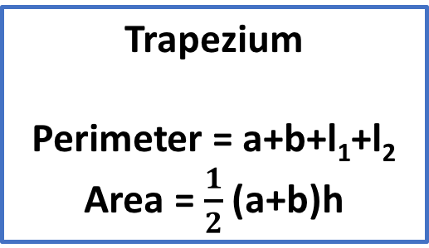
Parallelogram and trapezium
a
|
l
=
=
l₁
l₂
h
h
|
b
b
Parallelogram
Perimeter = 2(b+l)
Area = bh
Trapezium
Perimeter = a+b+l₁+l₂
Area = $\frac{1}{2}$ (a+b)h

Slide 8
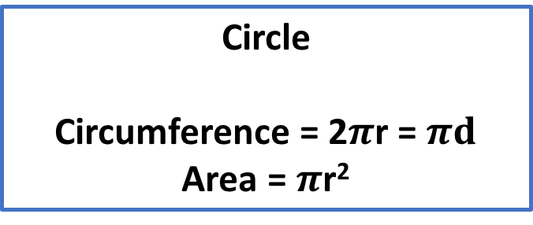
Circle
Radius, r
Circle
Circumference = 2$π$r = $πd$
Area = $π$r²
Diameter, d

Slide 9
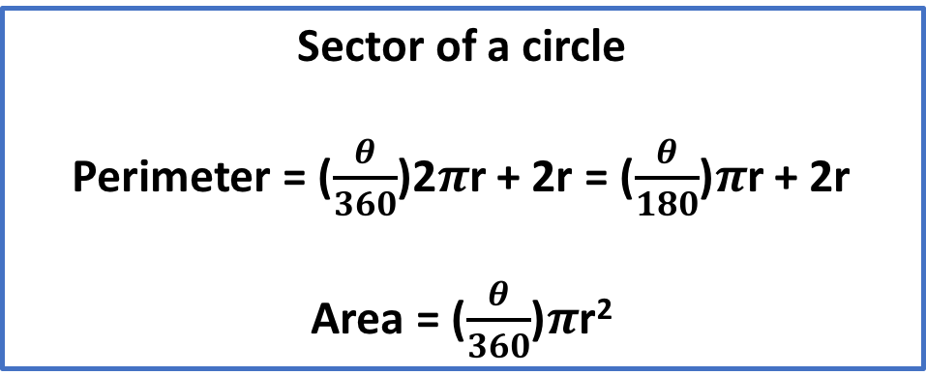

Sector of a circle
r
$$θ$$
Sector of a circle
Perimeter = ($\frac{θ}{360}$)2$π$r + 2r = ($\frac{θ}{180}$)$π$r + 2r
Area = ($\frac{θ}{360}$)$π$r²

Slide 12
Notes:
https://yoursay.northernbeaches.nsw.gov.au/TaniaPlay

Slide 13
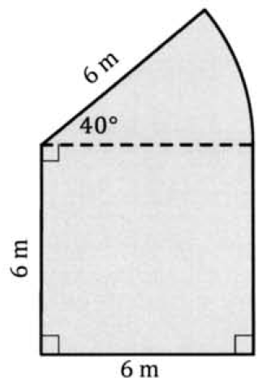
Example
Determine the perimeter and the area of the composite shape shown.

Slide 14
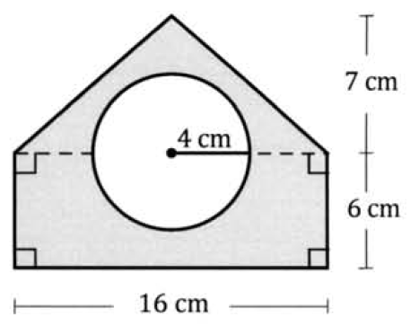
Examples
Mindy is planning to build a circular swimming pool in her backyard (as shown in the diagram) and paved the remainder. She would also like to fenced the pool as well as the paved area.
Calculate the area which is required to be paved.
Calculate the length of the fence required for the pool as well as the backyard.
If the cost of paving is $80/m², calculate the total cost required to paved the shaded area.
6 m
4 m
5 m
16 m

Slide 15
If a circle is to have an area of 18 cm², what must be the radius of the circle, to the nearest millimeter?

Slide 16
